Slide 1
Mid-Project Review
D.Purnendra Reddy - ME18B131
Guide: Prof. Pallab Sinha Mahapatra

Slide 2
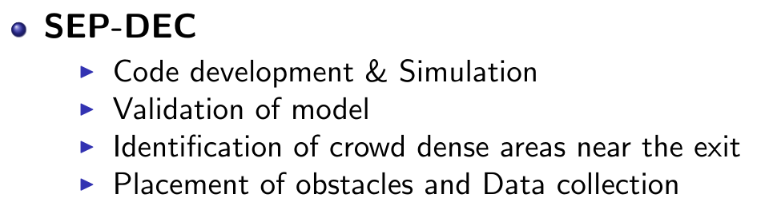
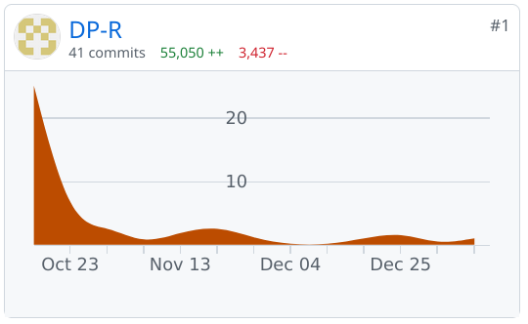
Progress since Sept 22
Progress (estimated)
Progress (present)
Completed development of code & Simulation
Compared model
Optimised code execution using matlab.

Slide 3
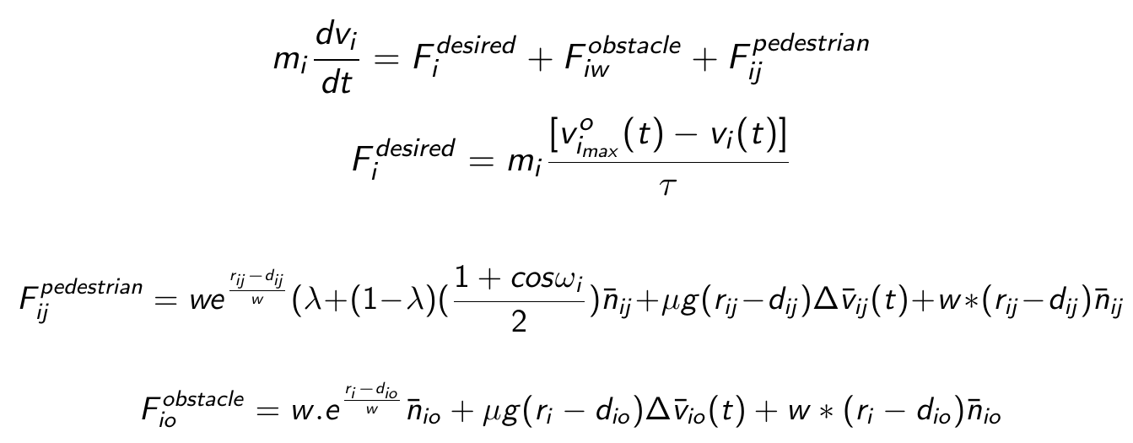
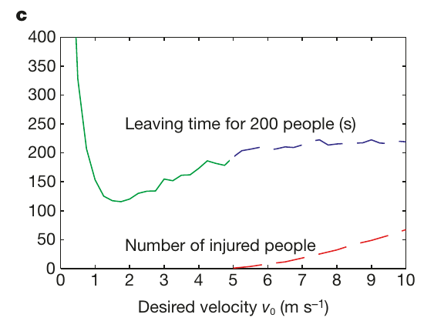
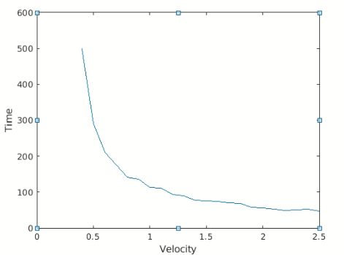
Qualitative comparison -Helbing’s social force model
Subjective comparison of the model
Non - deterministic
No constraint on crowd pressure

Slide 4

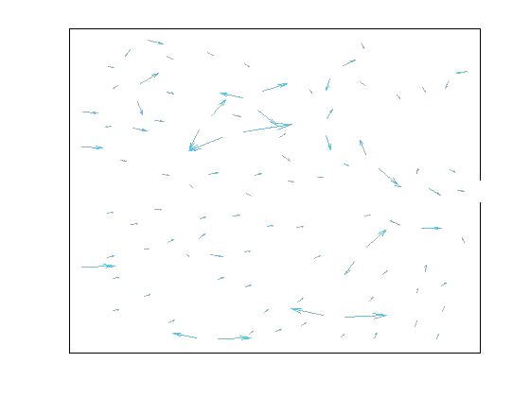
Workings of the model
Demonstration
Crowd agent positions with time
Time series velocity
Velocities of crowd agents with time
Changes represent the acceleration due to repulsion forces.

Slide 5
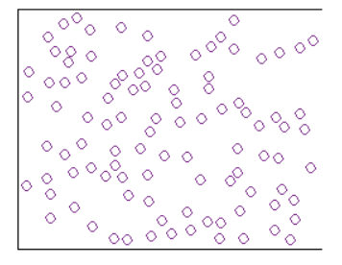
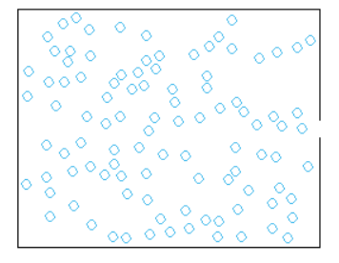
Crowd evacuation dynamics as an optimization problem
Best evacuation time? Having no walls
Trade-off Engineering requirements vs Efficient evacuation

Slide 6
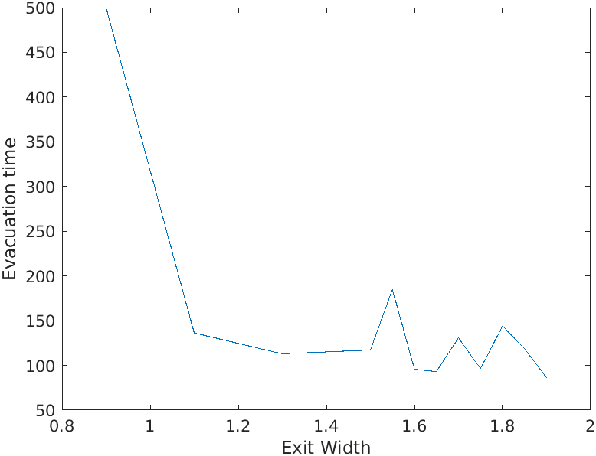
Parametric performance of model & Causal Analysis
Speed variation
With increase in agent desired velocity, evacuation time decreases.
No constraints on crowd pressures.
Exit width
Estimation: Evacuation time decreases with increase in exit width.
Observation: Oscillation in time for a range of exit width(s).
Checked: Random crowd initial positions.
Checked: Lowering time steps

Slide 7
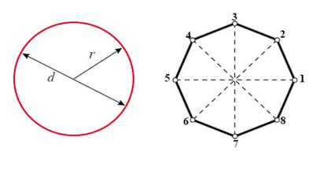

Methodology - Obstacle placement
Simplification of obstacle
Placement of obstacle at crowd dense locations.
Defining parameters of placement
Distance from exit
Lateral shift
Size of obstacle
Curved Objects

Slide 8
Methodology - Sensitivity analysis
Estimation of pressure density
Division of space into discretized nodes.
Crowd agents allotted to closest node
At t, Eulerian approach in treating pressure on the agents within the node.
Averaged over time:0,end
Sensitivity Analysis
Comparison of pressure density maps before and after placement of obstacles.
Output params: P,time
Input params: Object placement

